Slide 1
Debugging Tips & Tricks
Source code link: https://github.com/kbrainard1/SampleBugs

Slide 2
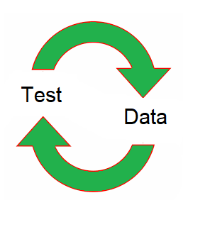
Debugging Philosophy
Quick iteration

Slide 3

Design for Debugability
Keep state as local as possible
Local variables
Parameters
Private data
Public data

Slide 4
Design for Debugability
Make shared data immutable wherever possible
Example: Builder pattern
WidgetBuilder newWidget = new WidgetBuilder();
newWidget.setSpinnerSpeed(getSpinnerSpeed());
newWidget.setNumberOfGears(numGears);
return newWidget.build();

Slide 5
Design for Debugability
Create wrapper classes to keep code logic in one file
public class WidgetCache {
private Map<Long, Widget> idToWidgetCache = new HashMap<>();
public Widget put(long id, Widget widget) {
return idToWidgetCache.put(id, widget);
}
public Widget get(long id) {
return idToWidgetCache.get(id);
}
public void clear() {
idToWidgetCache.clear();
}
}

Slide 6

Design for Debugability
Add comments about why the code does a thing, rather than what it does
// Wait 1 second
if (System.currentTimeMillis() - startTime < 1000) {
Thread.sleep(1000);
}
Vs.
// For unit tests with small toy datasets, sometimes the ‘read’ thread runs faster than the setup for
// the ‘work’ threads; make sure the work threads have started before signaling that reading is done
if (System.currentTimeMillis() - startTime < 1000) {
Thread.sleep(1000);
}
Comments are like leprechauns: untrustworthy but suggestive

Slide 7
Testing Tips
Write tests as you go along (Test Driven Development)
Smoke test code
public void testAddition() {
int result = new AddingMachine().add(2,3);
assert result == 5;
}

Slide 8


Testing Tips
Use tests to reproduce the bug in a controlled environment

Slide 9

Testing Tips
Add testing hooks in your code
Multi-threading
Unusual errors (server connections, etc)

Slide 10
Testing Tips
public class ServerConnection {
public Connection getConnection() {
testingHook();
return connection;
}
protected void testingHook() {
// does nothing, only implemented by tests
}
}
public class ServerTestSuite {
private boolean hasFailed = false;
private static class TestServerConnection extends ServerConnection {
protected void testingHook() {
if (!hasFailed) {
hasFailed = true;
throw new ServerConnectionException();
}
}
}

Slide 11
Challenging Environments
Println Debugging
Logging
Log4J
Log4cxx

Slide 12
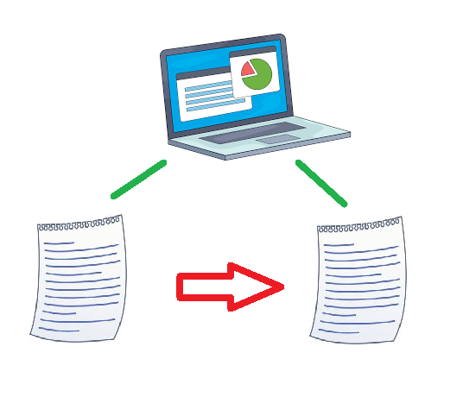
Challenging Environments
Live Config Changes

Slide 13

Challenging Environments
Simplify error handling
Wrap all threads/processes

Slide 14
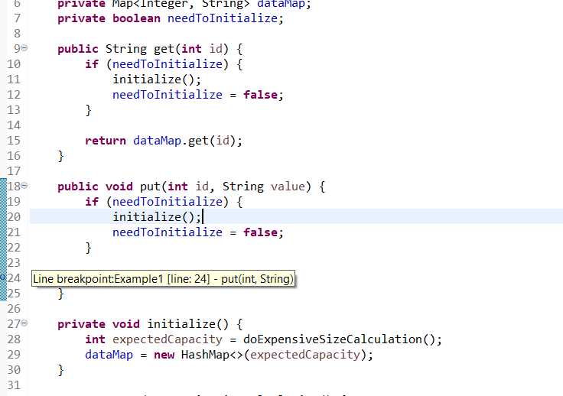
Useful IDE Tools
Breakpoints

Slide 15
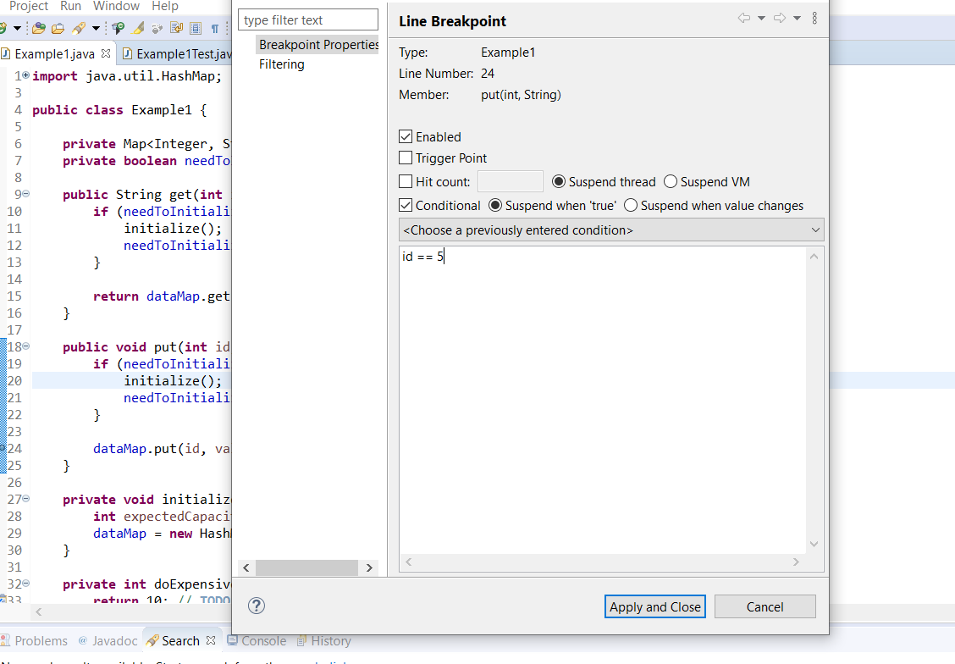
Useful IDE Tools
Conditional Breakpoints

Slide 16
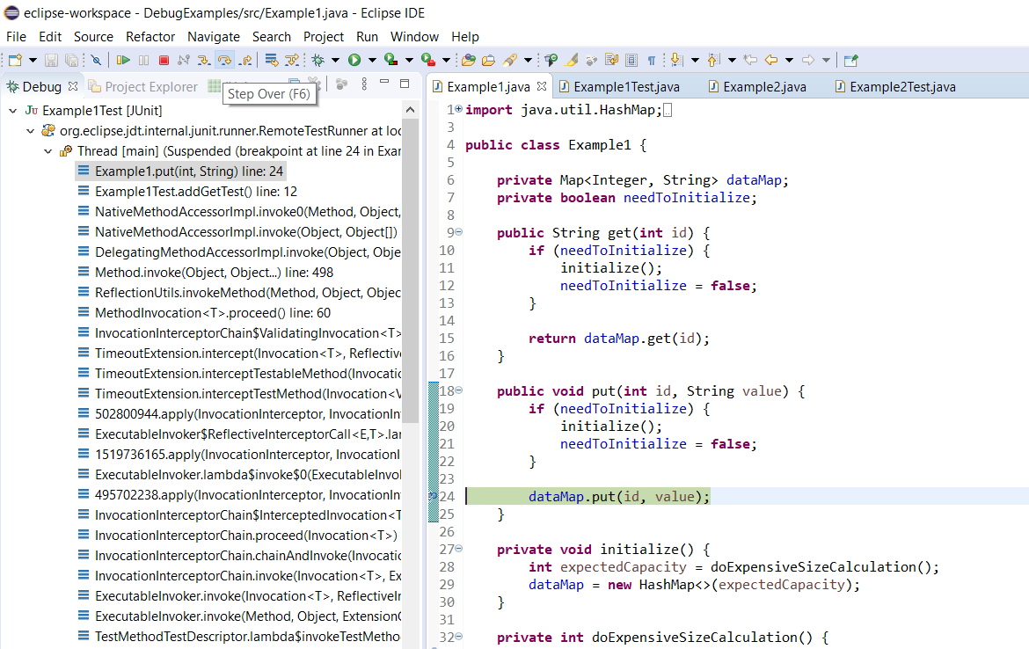
Useful IDE Tools
Control Flow: Step in/out/over

Slide 17
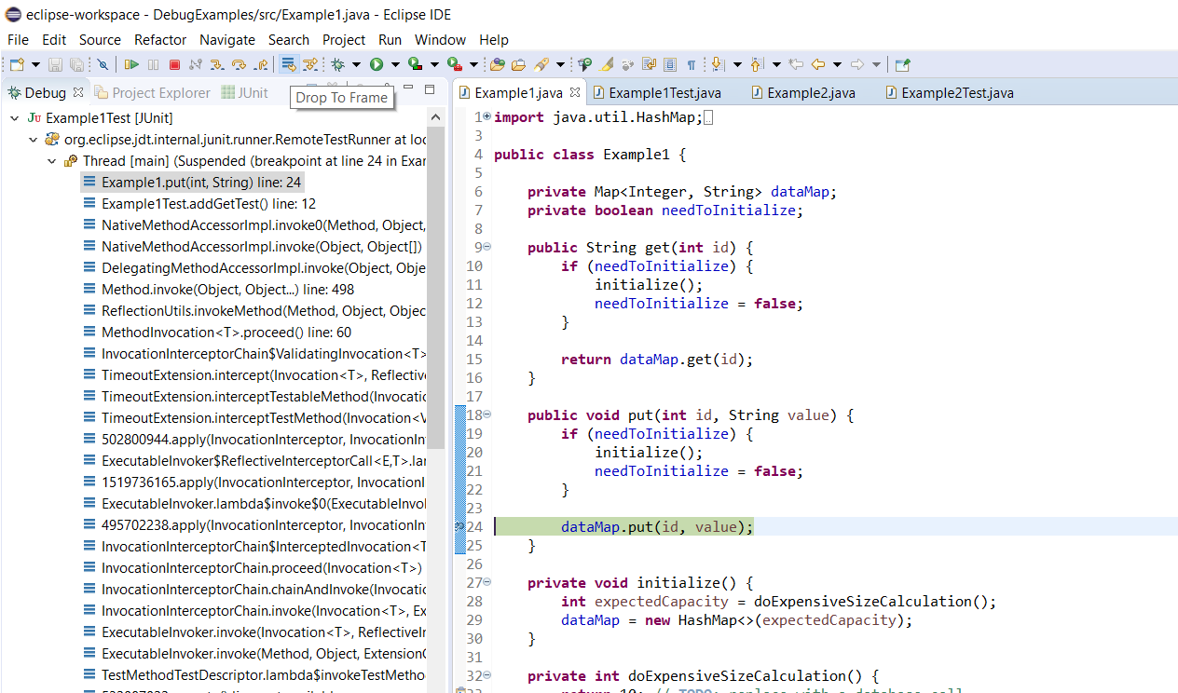
Useful IDE Tools
Drop To Frame/Reset Frame

Slide 18
Take it for a Test Drive!
https://github.com/kbrainard1/SampleBugs

Slide 19
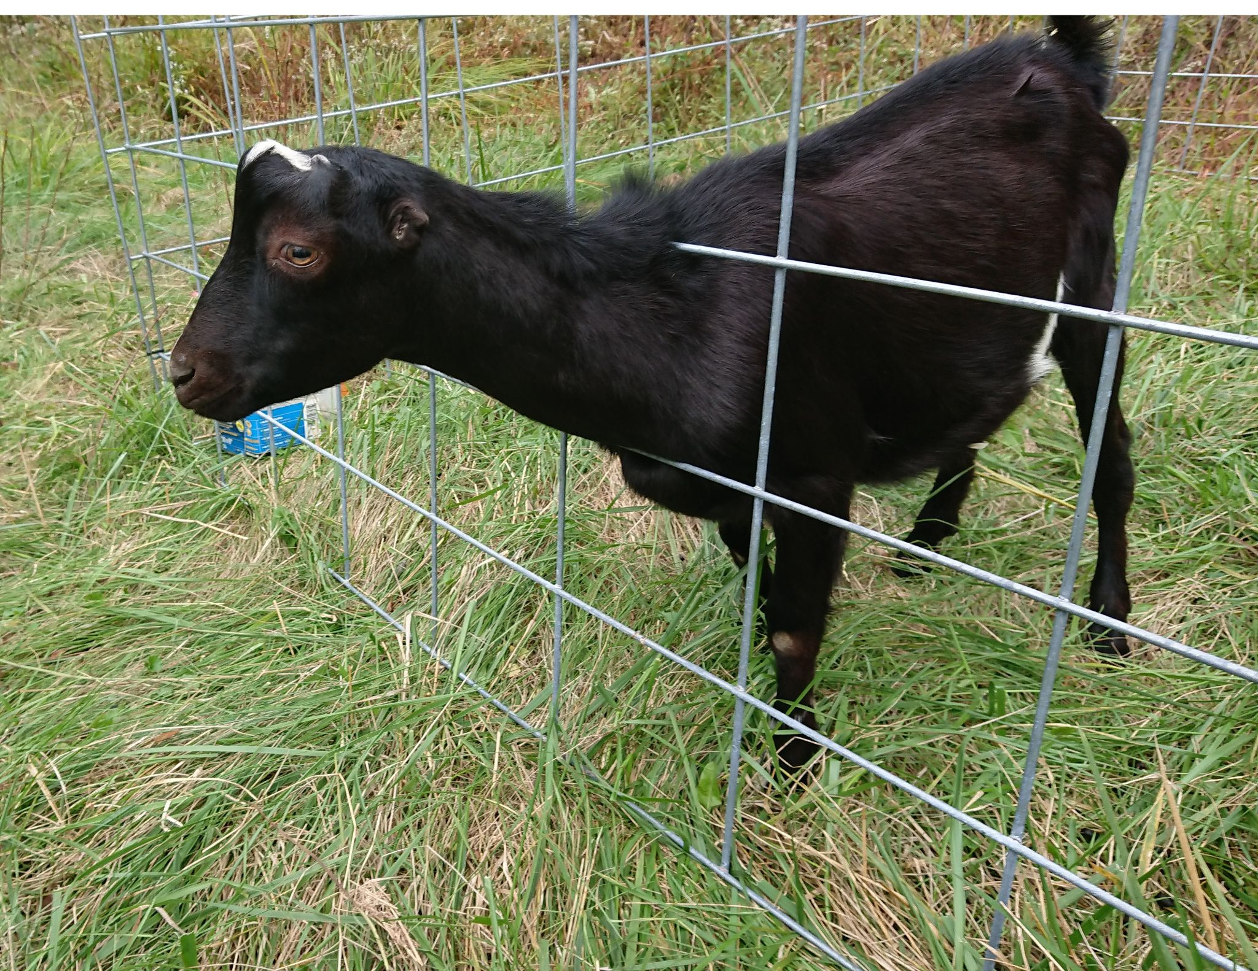
Questions?

